Slide 1
Core Java Programming
By: Saroj Singh

Slide 2
Java Architecture
Java Runtime Environment (JRE)
Class Loader
.java File
(Source Code)
Compile
.class File
(Byte Code)
Byte Code Verifier
Java Virtual Machine
Just-in-time Compiler
Executable Code
Execute
(Output)
Windows
OS
Linux
OS

Slide 3
Advantages of Java
Simple
Object Oriented
Distributed
Robust
Secure
Platform Neutral
Portable
Compiled and Interpreted
High Performance
Multithreaded

Slide 4
Compiling and Running Java Programs
Create java program and save it with extension .java
Name of the program should be same as the name of class
Compiling Java Program
Use javac command
>Javac xyz.java
Running Java Program
Use java command
>Java xyz
Example

Slide 5
Path and Classpath Variable
PATH is an environment variable that tells java virtual machine where to look for tools, such as javac.exe, java.exe, javadoc.exe etc.
CLASSPATH is a parameter that tells the class loader where to look for user-defined classes and packages.

Slide 6
Arrays in Java
Creating Arrays
Syntax
data-type a[]=new data-type[size]
data-type a[][]=new data-type[row][col]
Example
int a[]=new int[5] int m[][]=new int[3][3]
Accessing Arrays
Use index
Similar to accessing arrays in C and C++
Example Program

Slide 7
Arrays in Java
Methods of Array Class
binarySearch
fill
sort
equals
arrayCopy so on
Example

Slide 8
Reading From keyboard
Use object of Scanner class
Scanner sc=new Scanner(System.in)
Methods of Scanner class
next
nextInt
nextFloat
nextChar
nextLine so on
Example

Slide 9
Class and Object
Class is user defined type. It is used to create template for objects.
Class is collection of similar objects
Class contains member variables and methods
Declaring Class
Syntax
[Access][Modifiers] class className [extends superClass] [implements interface1, interface2……]
{ //body }

Slide 10
Class and Object
Example
class Box
{
int l, b, h;
void setData(int x, int y, int z)
{
l = x; b=y; h=z;
}
public int findArea()
{
return l*b;
}
public int findVolume()
{
return l*b*h ;
}
}

Slide 11
Class and Object
Object is instance of class. We can say that object is variables of type class
Memory is allocated for data members when object is created.
Creating Objects
Syntax
Class_Name Object_Name=new Class_Name()
Example
Box b=new Box() or Box b
b=new Box()
Program

Slide 12
Method Overloading
Many functions with same name but different signature.
It is a way of achieving polymorphism
Example

Slide 13
Constructors
Special type of method that is invoked automatically when object is created
Types: Default, Parameterized
Example

Slide 14
This Keyword
Represents currently active object
Used for: name conflict resolution and return currently active object
Example

Slide 15
Static Data Members and Member Function
Memory for instance variables or non-static variables is allocated at the time of creating objects whereas memory for static variables is allocated at the time of class declaration or we can say at compile time.
Same memory location is shared by all objects in case of static data members whereas each object has separate copy of non-static data members.
We can declare variable or method as static. Static methods are used for accessing static data members.
Static members can be accessed with object name or directly with class names
Example

Slide 16
Access Modifiers
Keywords that are used to define visibility of classes, methods and member variables are called access modifiers. The four access levels are:
Default
Private
Public
Protected
Example

Slide 17
Inheritance
Process deriving new class from existing class. Newly derived class is called derived class/child class/ sub class and existing class is called base class/parent class/ super class.
Types of Inheritance:
Single
Multiple – Not supported by java classes
Multi-level
Hierarchical
Hybrid
Syntax for Inheritance
Class derived-class-name extends base-class-name

Slide 18
Inheritance
Example of Single Inheritance

Slide 19
Method Overriding
Child class have method whose signature is same as signature of method in parent class.
Example

Slide 20
Dynamic Method Dispatch
It is the way of achieving dynamic polymorphism.
The decision of which method to call is only made at run time.
Example

Slide 21
Final Modifier
It can be used for following purposes.
To Define Constants: we can use final modifier with variables to declare them as constant.
To Prevent Overriding: We can prevent a method being overridden from subclass by declaring it as final.
To Prevent Inheritance: We can use final modifier with class declaration to prevent it from further inheritance.

Slide 22
Interfaces
An interface is a reference type, similar to a class that can contain only constants, and method declarations.
Interfaces cannot be instantiated—they can only be implemented by classes or extended by other interfaces.
By default all variables defined in interfaces are constants and all the members in an interface are public
Example
interface Shape
{
float PI = 3.1415f;
void area();
}

Slide 23
Interfaces
Interfaces supports multiple inheritance. A class can extend only one another class but can implement any number of interfaces.
Example

Slide 24
Abstract Classes and Methods
The keyword abstract is used to create a class as an abstract class and it must contain abstract methods.
Likewise, if you need your method to be always overridden before it can be used, you can declare the method as an abstract method using abstract keyword and without the method definition.
We can not create object of abstract classes. If you declare some method as an abstract method, you must declare your class as abstract.

Slide 25
Abstract Classes and Methods
Example
public abstract class A
{
………
………
public abstract void mymethod1(); //no definition
void myMethod2()
{
//……definition here
}
}
Interfaces vs. Abstract Classes????

Slide 26
Packages
Package can be defined as a grouping of related types(classes, interfaces, enumerations and annotations )
Packages are used
to prevent naming conflicts
to control access
to make searching/locating and usage of classes, interfaces, enumerations and annotations easier, etc.
Some of the existing packages in Java are: java.lang , java.io, java.util etc.

Slide 27
Packages
Using Packages
There are two ways of accessing classes in another package:
Using fully qualified name
jav.util.Date today = new java.util.Date();
Using import statement
import java.util.*;
import java.util.Scanner;
What happens if two imported package contains same class?
import java.util.*;
import java.sql.*; //both contains Date class

Slide 28
Packages
Creating Packages
Put the package statement in the first line in the source file.
Example
package P1;
public class A
{
public void show()
{
System.out.println("From Class A of Package P1");
}
}
Compile above file and put the file class file in a sub-directory P1.

Slide 29
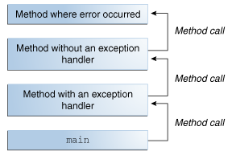
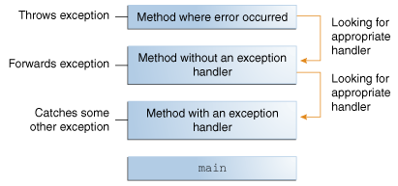
Exception Handling
An exception is an event, which occurs during the execution of a program that disrupts the normal flow of the program's instructions.
Two main activities: Throwing Exception, and Handling Exception

Slide 30
Exception Handling
Categories of Exception Handling
Checked Exceptions: IOException, SQLException etc
Unchecked Exceptions: ArrayIndexOutOfBoundsException, ArithmeticException, NullPointerException etc
Errors: hardware failure, JVM crash or out of memory error

Slide 31
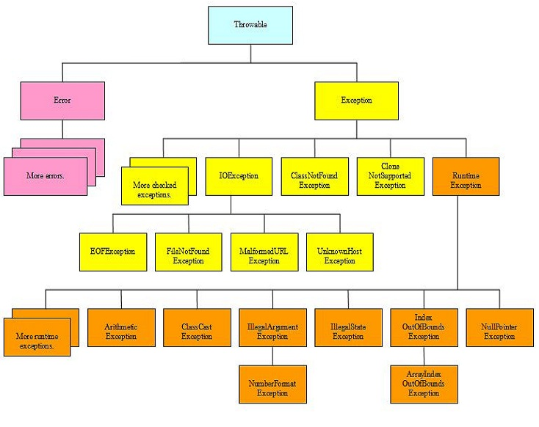
Exception Handling

Slide 32
Exception Handling
Handling Exceptions with try…..catch
A try block is used to enclose the code that might throw an exception. It must be used within the method. Java try block must be followed by either catch or finally block.
Java catch block is used to handle the Exception. It must be used after the try block only.
Example

Slide 33
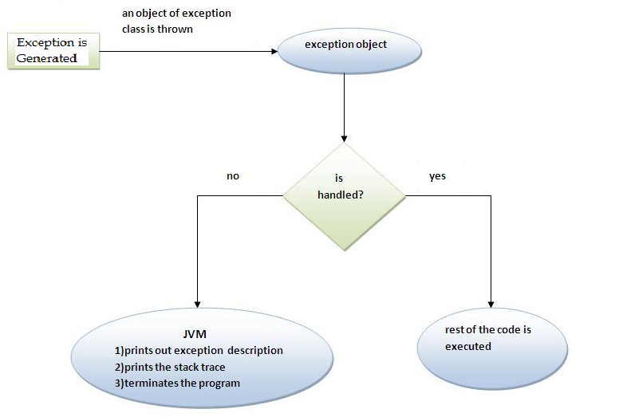
Exception Handling
Handling Exceptions with try…..catch

Slide 34
Exception Handling
Multiple Catch Block
A try block can be followed by any number of catch blocks. All catch blocks must be ordered from most specific to most general.
Even if there is possibility of occurring several exceptions, at a time only one exception is occurred and at a time only one catch block is executed.
Example

Slide 35
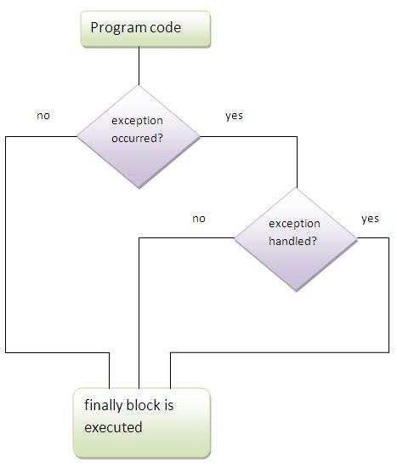
Exception Handling
Finally Block
Example

Slide 36
Exception Handling
The throws Keyword
If a method does not handle a checked exception by using try….catch…finally blocks, the method must declare it using the throws keyword. It throws the exception to immediate calling method in the hierarchy.
In this case, either the calling method should have try…..catch block to handle the exception or should use throws keyword and forward the exception to its caller.
If all calling methods are using throws and no more calling method is available to handle the exception, JVM itself will handle the exception.
Example

Slide 37
Exception Handling
The throw Keyword
The Java throw keyword is used to explicitly throw an exception.
Example

Slide 38
Multithreading
The main purpose of multithreading is to provide simultaneous execution of two or more parts of a program to maximum utilize the CPU time.
A multithreaded program contains two or more parts that can run concurrently. Each part of such a program called a thread.

Slide 39
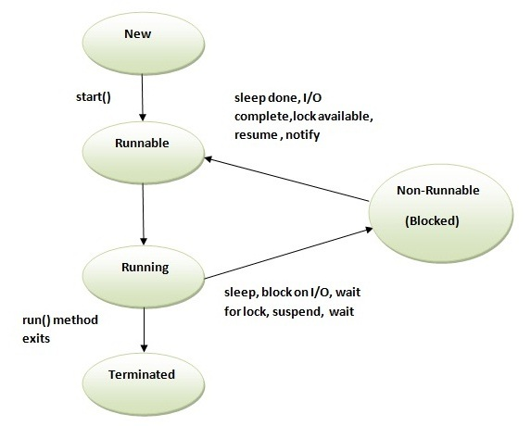
Multithreading
Thread Life Cycle
.

Slide 40
Multithreading
Multithreading Implementation
A thread can be created in two ways:
By extending Thread class
By implementing Runnable interface.

Slide 41
Multithreading
Multithreading by Extending Thread Class
This way of thread implementation can be formalized into following three steps:
Override run() method
public void run()
Create Object of Thread Class
Invoke start() method
void start()
Example

Slide 42
Multithreading
Multithreading by Implementing Runnable Interface
This way of thread implementation can be formalized into following three steps:
Override run() method
public void run()
Create Object of Thread Class
Thread(Runnable th, String tname) or
Thread(Runnable th)
Invoke start() method
void start()
Example

Slide 43
Thread Priorities
We can set priorities of java threads. Java provides setPriority() and getPrority() methods for setting and reading priorities of threads.
Value of priority can range from 1-10. Default value of priority is 5.
Maximum priority of thread is 10 and minimum priority is 1.
High priority threads can get more chances of execution from JVM. However, exact behavior depends upon JVM.
Example

Slide 44
Thread Synchronization
Synchronization means only one thread must be able to use shared resource at a time.
If threads are not synchronized properly, it may lead to problem of race condition.
Synchronized keyword is used in java for synchronizing threads.
Example

Slide 45
Inter Thread Communication
Interthread communication is about synchronized threads to communicate with each other.
It is the mechanism in which a thread is paused in its critical section and another thread is allowed to run in the same section. It implemented by following three methods
wait(): It causes thread to wait until another thread calls notify() or notifyAll() method.
notify(): It wakes up single thread that is sleeping its monitor.
notifyAll(): It wakes up all threads that is sleeping its monitor.

Slide 46
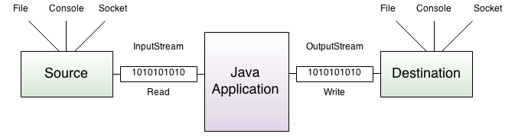
File Handling
Java uses the concept of stream to make I/O operation fast. The java.io package contains all the classes required for input and output operations. A stream is a sequence of data. In Java a stream is composed of bytes. In java, 3 streams are created for us automatically. All these streams are attached with console.
System.out: standard output stream
System.in: standard input stream
System.err: standard error stream

Slide 47
File Handling
Byte Stream Classes
Java byte streams are used to perform input and output of 8-bit bytes. Though there are many classes related to byte streams but the most frequently used classes are, FileInputStream and FileOutputStream.
Example

Slide 48
File Handling
Character Stream Classes
Java Character streams are used to perform input and output for 16-bit Unicode. Though there are many classes related to character streams but the most frequently used classes are, FileReader and FileWriter.
Example

Slide 49
File Handling
Random File Access
RandomAccessFile class in java.IO API allows us to move back and forth in the file and we can read or write content in any required place of file.
Before using RandomAccessFile class, we must instantiate it as below:
RandomAccessFile file=new RandomAccessFile(file-name,mode)
Once the class is instantiate we can move to the required location by calling seek() method and we can find the value of current position by calling getPointer() method.
Example

Slide 50
File Handling
Reading and Writing Objects
Java object Serialization is an API that allows us to serialize Java objects. Serialization is a process to convert objects into a writable byte stream. Once converted into a byte-stream, these objects can be written to a file. The reverse process of this is called de-serialization.
A Java object is Serializable if its class implement the java.io.Serializable interface.
ObjectInputStream and ObjectOutputStream classes are used to read/write java objects
Example

